Slide 1

FREE Islamic Resources for Educational Institutions
Creative Commons Non-Commercial, No-Derivatives License

Slide 2
What is a Mosque?
www.learn-islam.co.uk

Slide 3
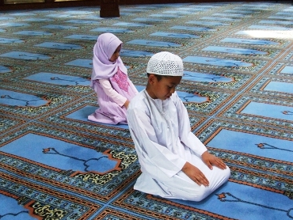
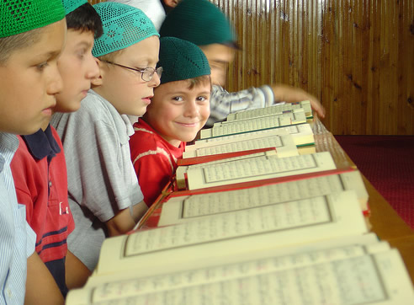
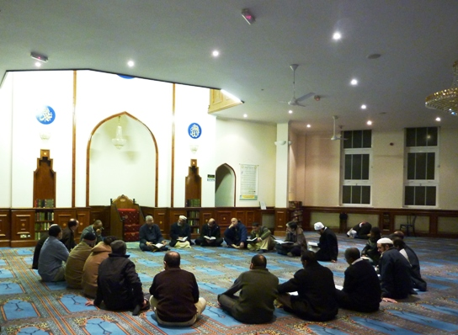
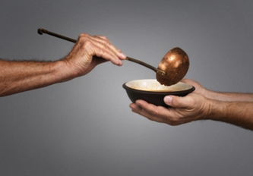
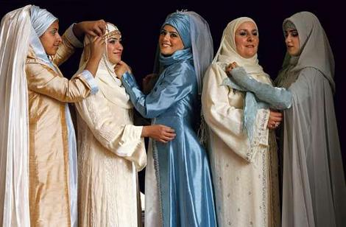
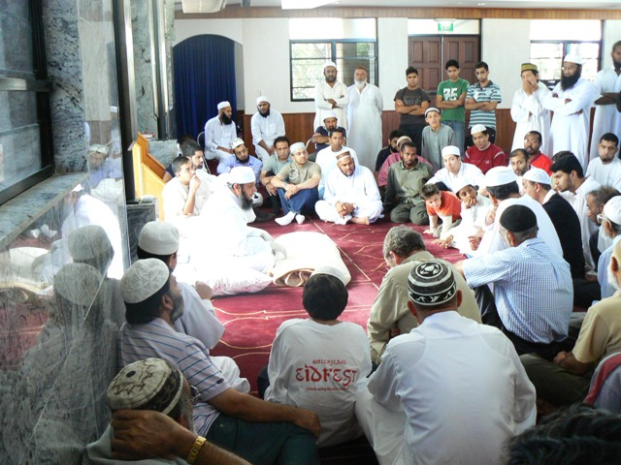
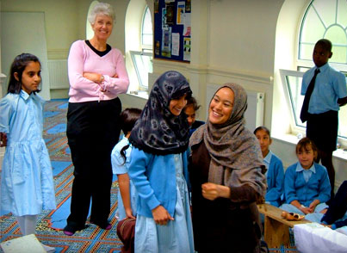
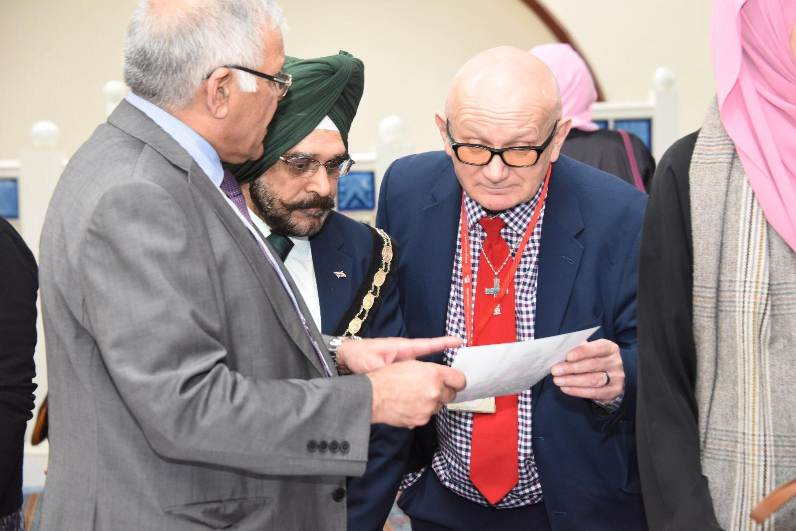
Prayers
Teaching
Advice
Charity
Weddings
Funerals
School Visits
Community
www.learn-islam.co.uk

Slide 4
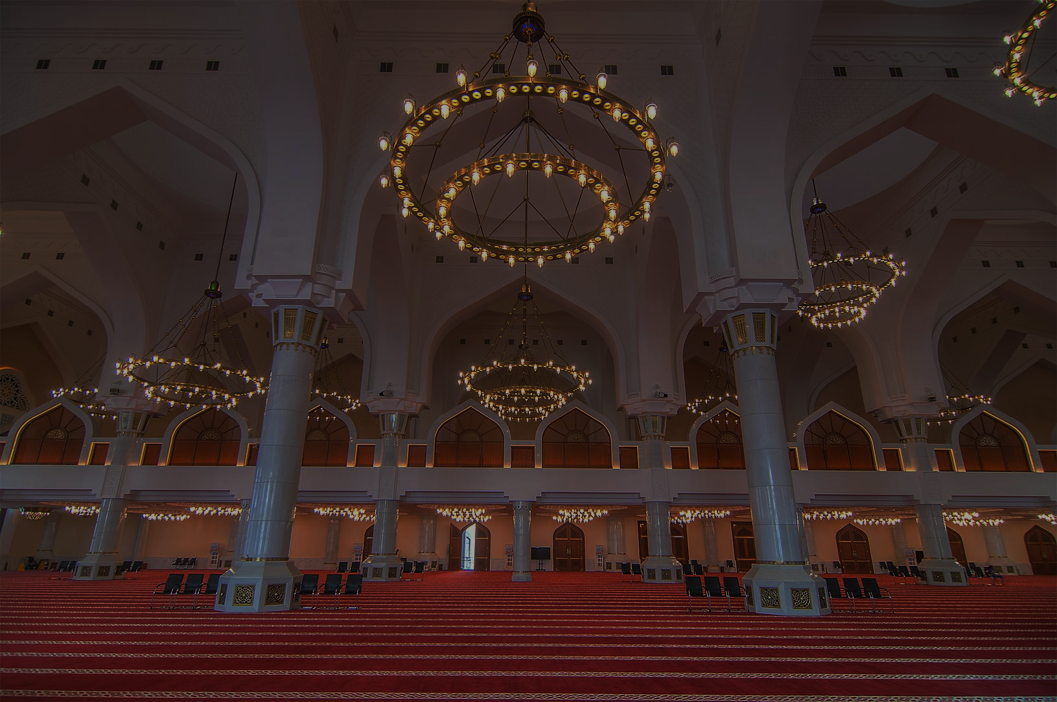
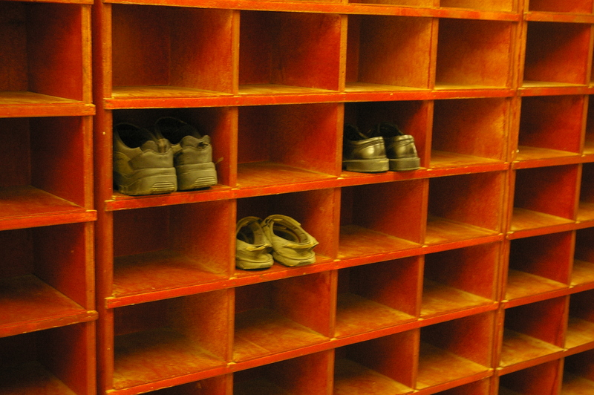
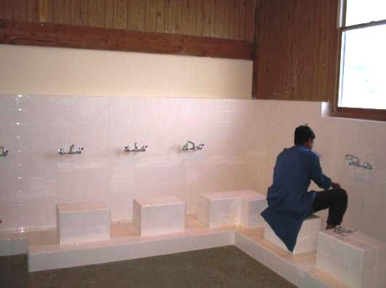
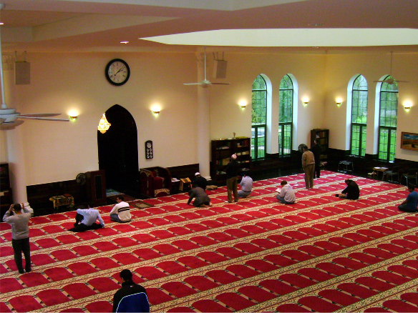
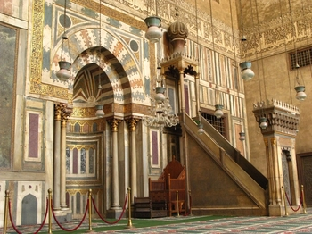
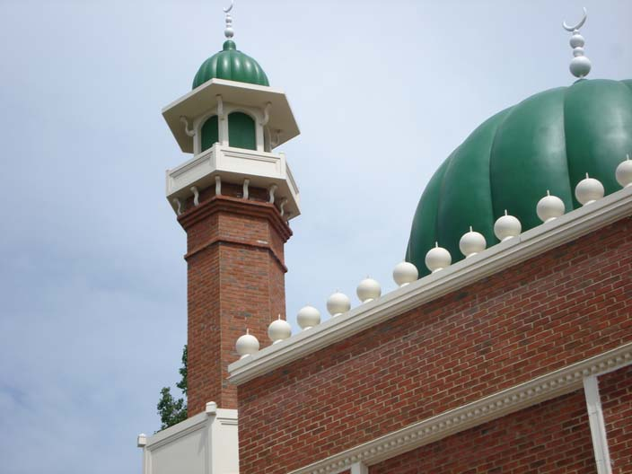
Main areas of the Mosque
Shoe Racks
Wudhu / Ablution
Prayer Hall
Mehrab / Minbar
Minaret
www.learn-islam.co.uk

Slide 5
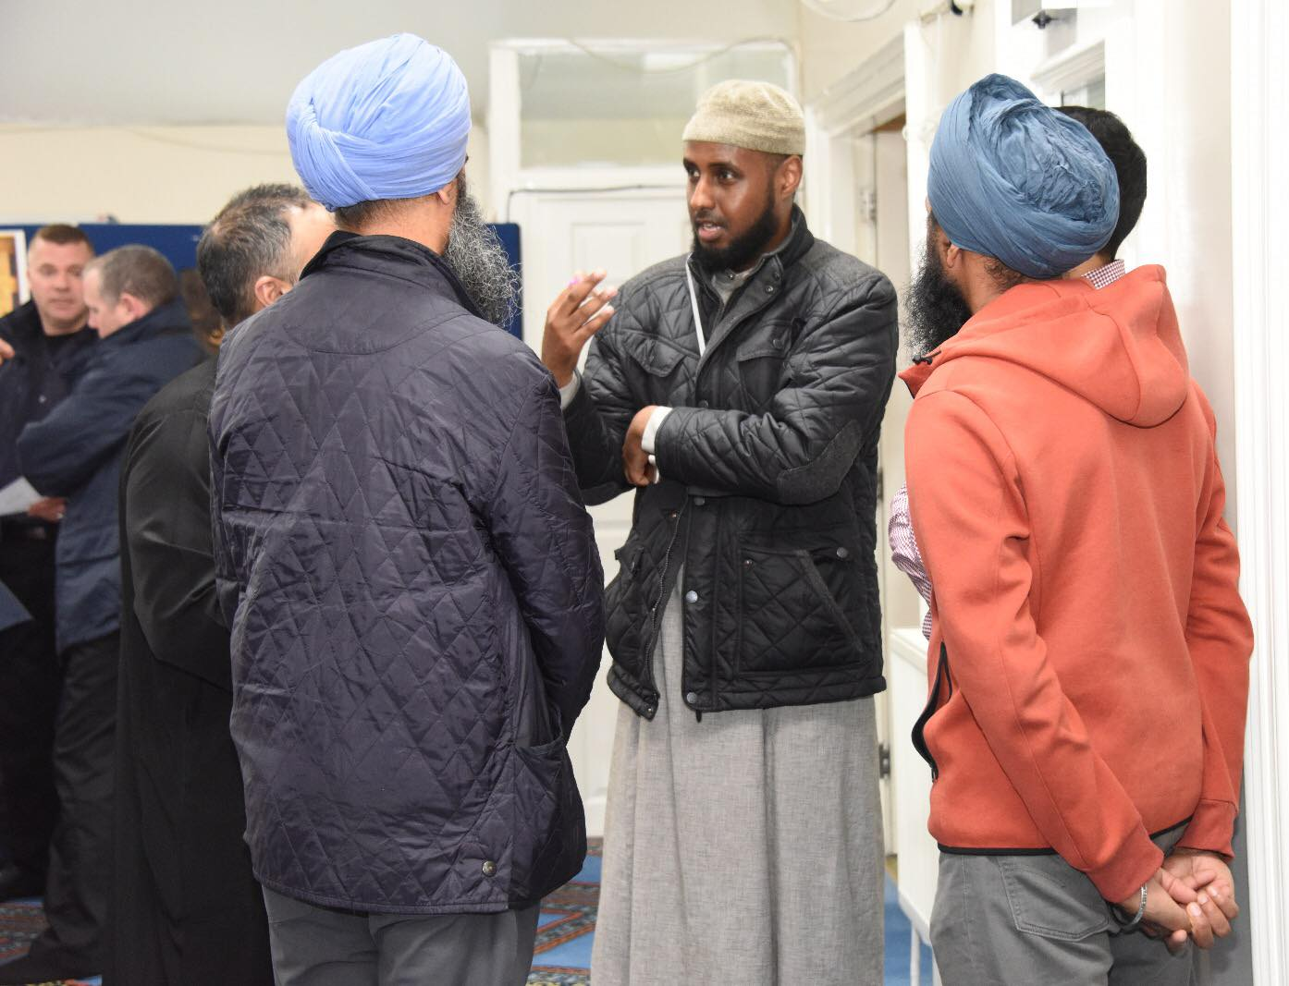
The Imam
Islamic Leader
Leads Prayers
Gives Advice
Nikah’s (Marriages)
Leads a normal life
Is allowed to get married
An Imam knows the Quran
by memory and it’s meaning
www.learn-islam.co.uk

Slide 6
Visit www.learn-islam.co.uk for more resources

