Slide 1

FREE Islamic Resources for Educational Institutions
Creative Commons Non-Commercial, No-Derivatives License

Slide 2
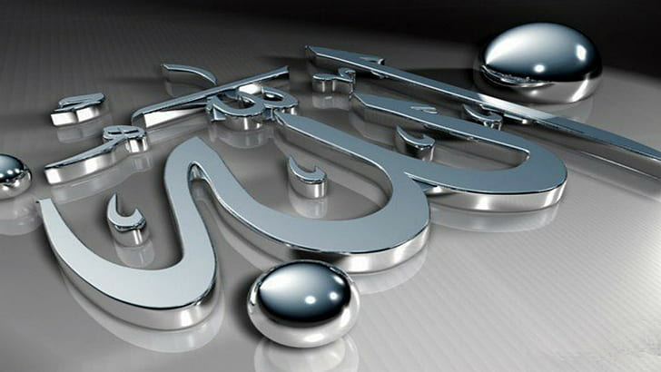
Shirk
Association of partners with Allah
www.learn-islam.co.uk

Slide 3
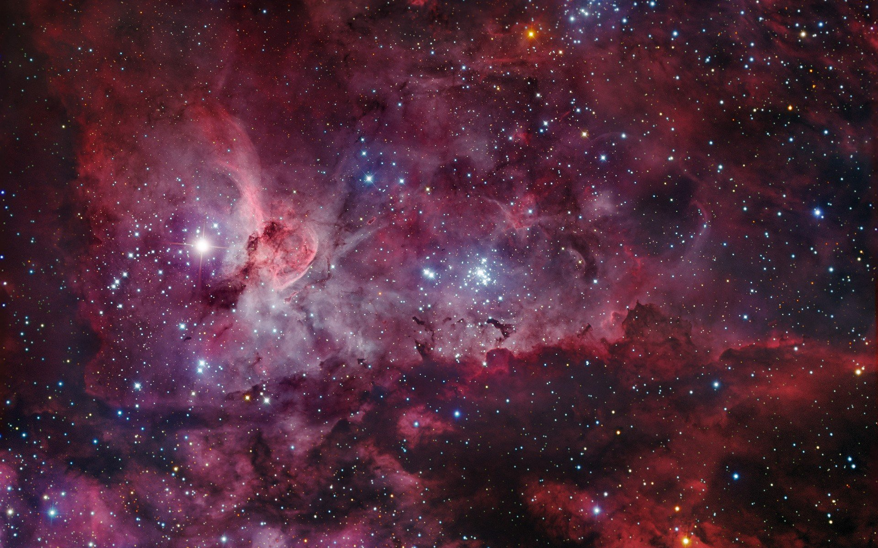
"Verily, Allah forgives not the sin of setting up partners in worship with Him, but He forgives whom He wills sins other than that. And whoever sets up partners in worship with Allah, has indeed strayed far from the path." (4:116)
"If you join others in worship with Allah, then surely all your deeds will be in vain, and you will certainly be among the losers." (39:65)
www.learn-islam.co.uk

Slide 4
Major Shirk
www.learn-islam.co.uk

Slide 5
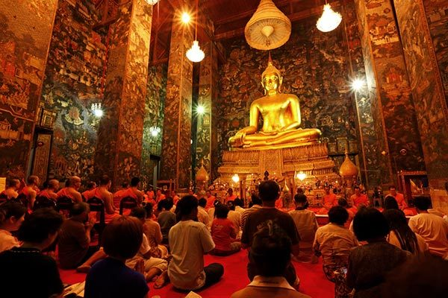
Supplication
or praying for help, guidance and protection, etc., from others than Allah
www.learn-islam.co.uk

Slide 6
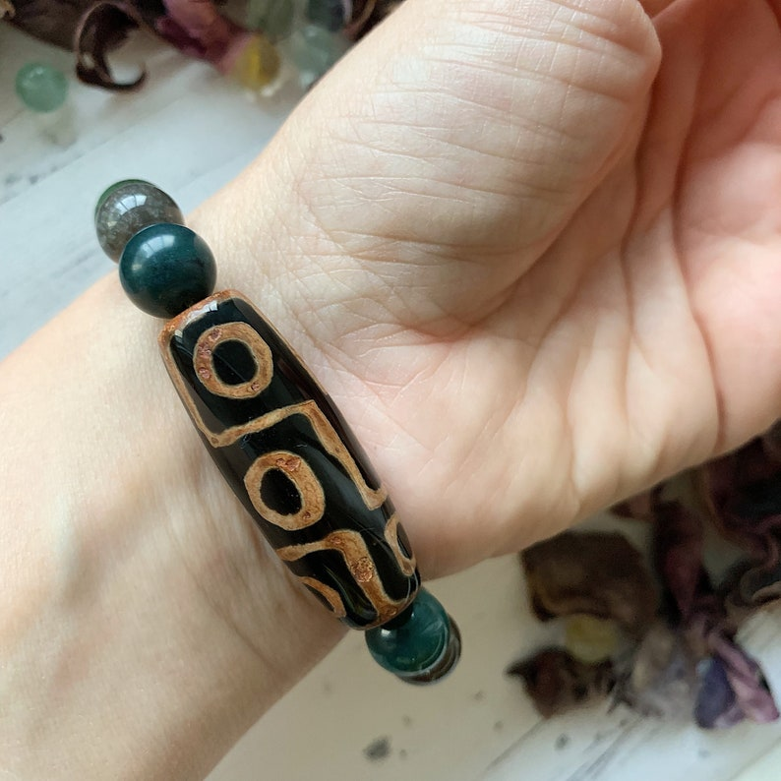
Believing that objects have special "powers" of healing or good luck, even if that object includes Quranic writing or some other Islamic symbolism
www.learn-islam.co.uk

Slide 7
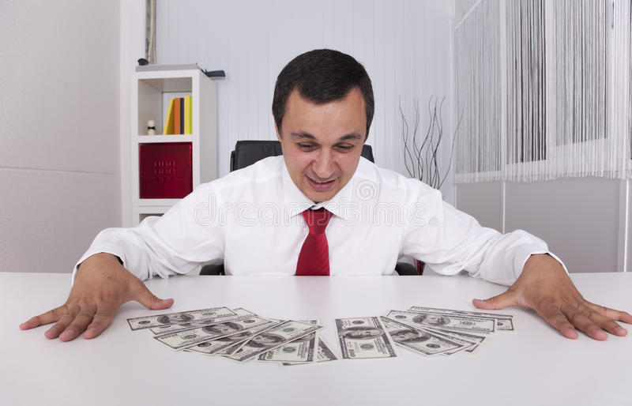
Finding your purpose in life from material pursuits, desiring and intending for something other than Allah
www.learn-islam.co.uk

Slide 8
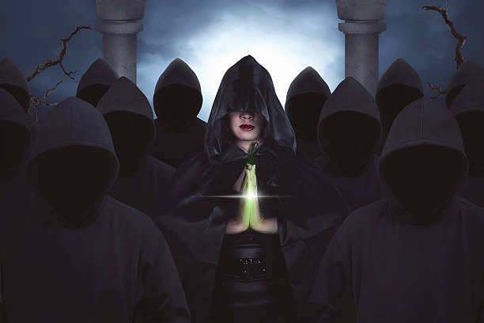
Obeying others over Allah; showing that you are ready to disobey Allah's guidance when it suits you
www.learn-islam.co.uk

Slide 9
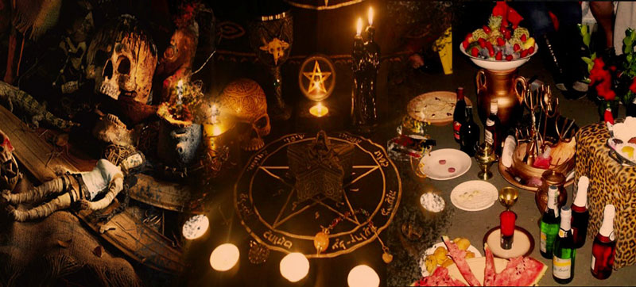
Engaging in magic, sorcery or fortune telling that attempts to see the unseen or predict future events - only Allah knows such things
www.learn-islam.co.uk

Slide 10

Minor Shirk
Swearing on someone other than Allah
Ar-Riya – Doing good for others to see you as a good person.
Wearing amulets, if believing then it is major shirk
www.learn-islam.co.uk

Slide 11
Minor Shirk (Ar-Riyya)
It is so dangerous that the Prophet ﷺ gave it a special name.
He said, “Indeed the thing I fear for you the most is the minor shirk
Major shirk is like worshipping a statue or another god with Allah (swt) or to take a legislator other than Allah (swt).
The thing he fears for us the most. He was asked, “What is minor shirk, ya Rasullah?” He said, “Ar-riyaa. Showing off.”
Example of someone making Athan and while making the Athan he thinks, “Wow I bet the people think my voice is beautiful.”
Ar-Riyya
(Associating partners with Allah).”
Major Shirk = Left the fold of Islam
Minor Shirk = Can lead to Major Shirk
Intention is very important (Why are you doing it?)
www.learn-islam.co.uk

Slide 12
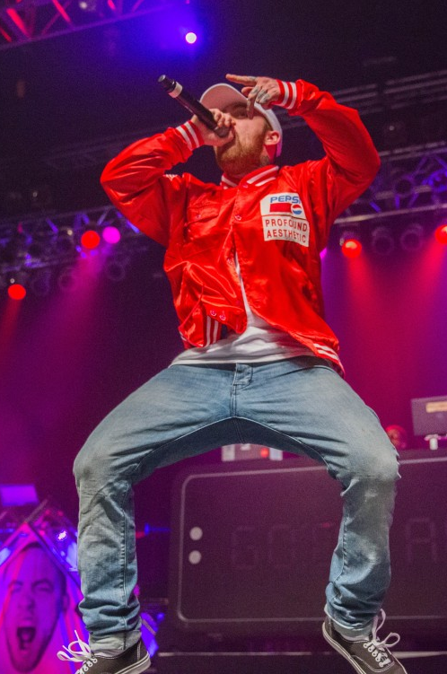
Minor Shirk (Ar-Riyya)
You might be doing bad and think, “Yeah them bros and girls will see how I’ve got it going on! They’re going to think I’m all that.” This is riyaa.
In fact 99% of hip-hop music is riyaa. “Look at me, I’m the baddest dude on the block, I got more girls than stars in the sky, best cars, I can drink more than the Pacific Ocean.
It’s because of me that the world’s in motion.” This is riyaa! This is showing-off and exaggeration.
www.learn-islam.co.uk

Slide 13
Examples from the Quran
Verily, whosoever sets up partners in worship with Allah, then Allah has forbidden Paradise for him, and the Fire will be his abode.
[Al-Ma`idah 5:72]
www.learn-islam.co.uk

Slide 14
Examples from the Quran
Those on whom you call besides Allah, cannot create (even) a fly, even though they combine together for the purpose. And if the fly snatched away a thing from them, they would have no power to release it from the fly. So weak are (both) the seeker and the sought.
Quran (22:73)
www.learn-islam.co.uk

Slide 15

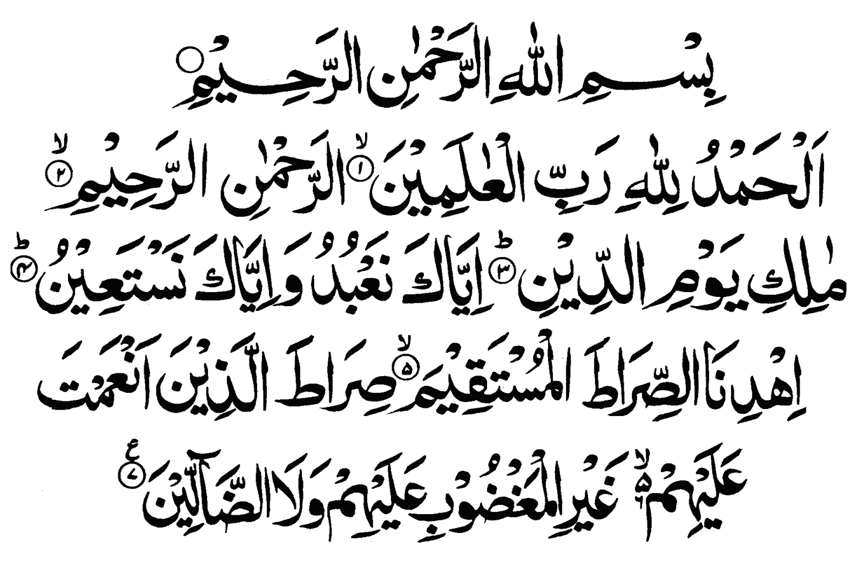
Examples from the Quran
You Alone we Worship. You Alone we ask for help.
www.learn-islam.co.uk

Slide 16

Examples
Did they commit shirk?
www.learn-islam.co.uk

Slide 17
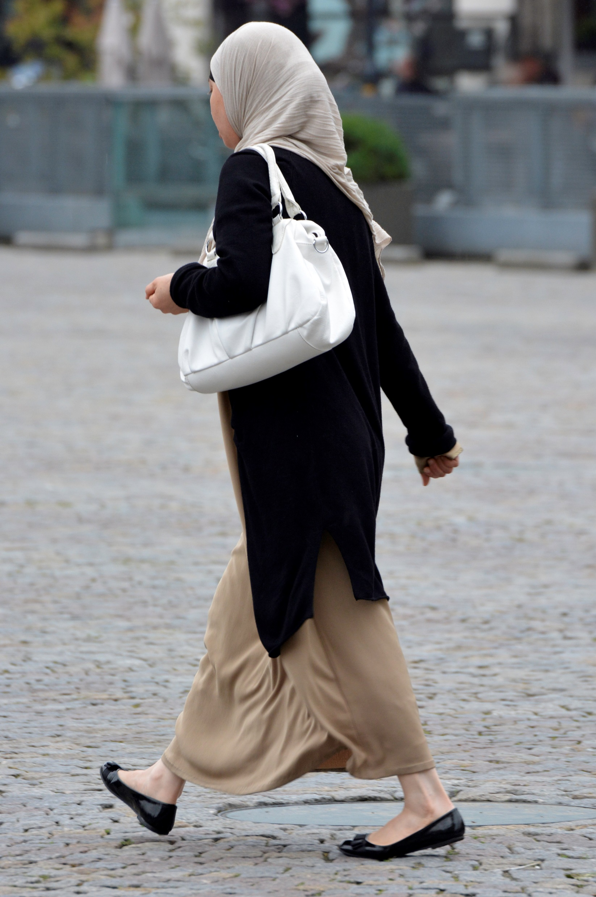
1.Did Aisha commit shirk?
Aisha Goes to School
She now carries the black crystal in her bag
Believes in Allah, prays 5 times, reads Quran everyday
She suffers from illness, prayed to Allah to give her shifa
A person gave her a black crystal and her illness went away
Believes with Allah’s help, the crystal ensures no illness will come
www.learn-islam.co.uk

Slide 18
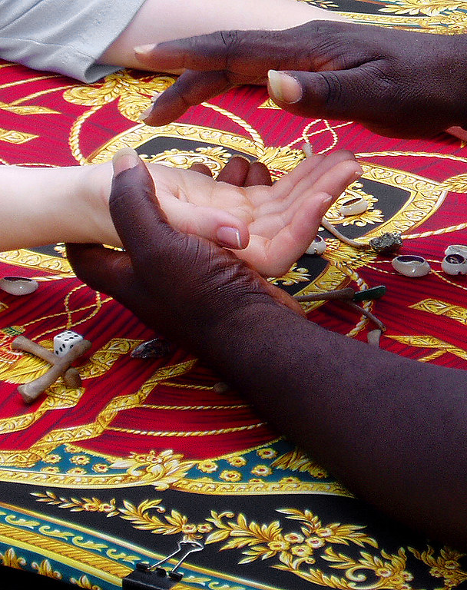
2.Did Saad commit Shirk?
Saad goes to the fun fair with his friends
They see a palm reader, the friends say “Let’s check it out?”
Saad goes in because he doesn’t want to look bad
The palm reader tells him he will marry a lovely girl
After Saad reaches home, he asks Allah for forgiveness
Saad does not believe the palm reader
www.learn-islam.co.uk

Slide 19
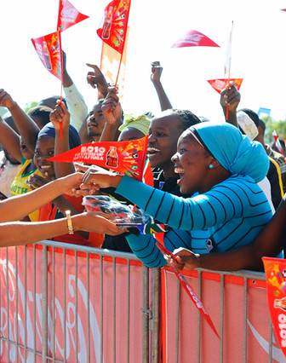
3.Did Malaika commit Shirk?
Malaika always admired Mo Farah
Since a child she wished to meet him one day
Skip salaah to watch his latest videos, then do Kazah
Worked extra to make enough money to visit him
Spent all money to see him instead of going Hajj
Had banners, photos, spoke about him all the time
Her eyes, face brightened whenever she heard of him
www.learn-islam.co.uk

Slide 20
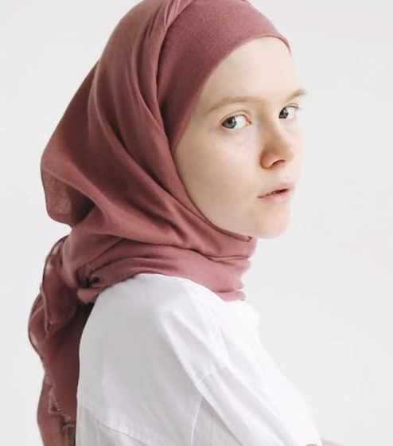
4.Did Taiba commit Shirk?
Taiba goes to the doctor for help
She asks him for help about for her illness
The doctor examines her
She’s prescribed the right medicine
Taiba goes to the pharmacy and collects her medicine
She takes the medicine and gets better in 2 days
www.learn-islam.co.uk

Slide 21
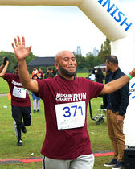
5.Did Hussain commit Shirk?
Hussain decided to raise money for charity
He ran a 10 mile marathon against 400 others
Advertised it all over social media, Instagram, TikTok, Twitter
He quickly reached his target of £5K
Donated it to the charity of his choice
Believes sharing photos with others motivates them to do good
Posted photos showing everything he did to others
www.learn-islam.co.uk

Slide 22
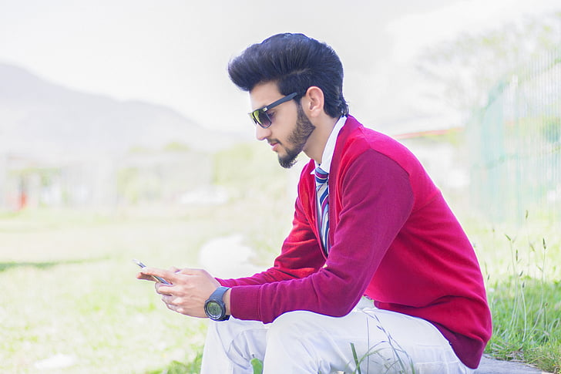
6.Did Ibrahim commit Shirk?
Ibrahim receives a message
It says “forward this or something bad will happen”
He reads it, laughs at it and ignores it
Later his best friend argues with him and leaves
He now believes it was the message and forwards it
Every message like that now he forwards it
www.learn-islam.co.uk

Slide 23

7.Did Zarah commit Shirk?
Zarah loves Instagram
Her breakfast, walks, makeup, nice places, etc…
She likes followers to believe she leads an awesome life
She believes she is teaching her haters a lesson
Now she removed her hijab to please the followers
She posts her daily life on it
Although her life is quite average
She promised to remove her hijab if she gets 10k followers
Her followers loved it and her account keeps growing
www.learn-islam.co.uk

Slide 24
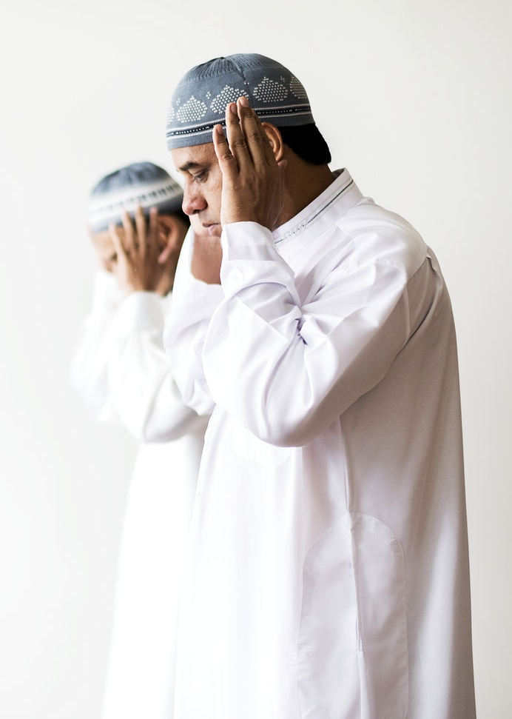
8.Did Abdul commit Shirk?
Abdul leads a very busy life, leaves for work after praying Fajr
Has to deliver goods all day, claims he has no time at work to pray
As soon as he gets home he makes up for his missing prayers
He does this quite regularly, missing Salaah has become a habit
www.learn-islam.co.uk

Slide 25
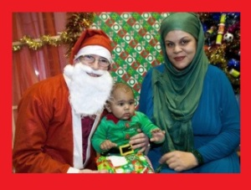
9.Did Fatima commit Shirk?
Fatima loves Christmas
She is a devout Muslim, prays 5 times
Says as Muslims we should respect all religions
During Christmas, she joins in the fun
Taking pictures with Santa, Turkey meal, gifts
Puts Christmas tree at home, loves the decorations
Believes it promotes respect with Christians
www.learn-islam.co.uk

Slide 26
Visit www.learn-islam.co.uk for more resources

