Slide 1

FREE Islamic Resources for Educational Institutions
Creative Commons Non-Commercial, No-Derivatives License

Slide 2
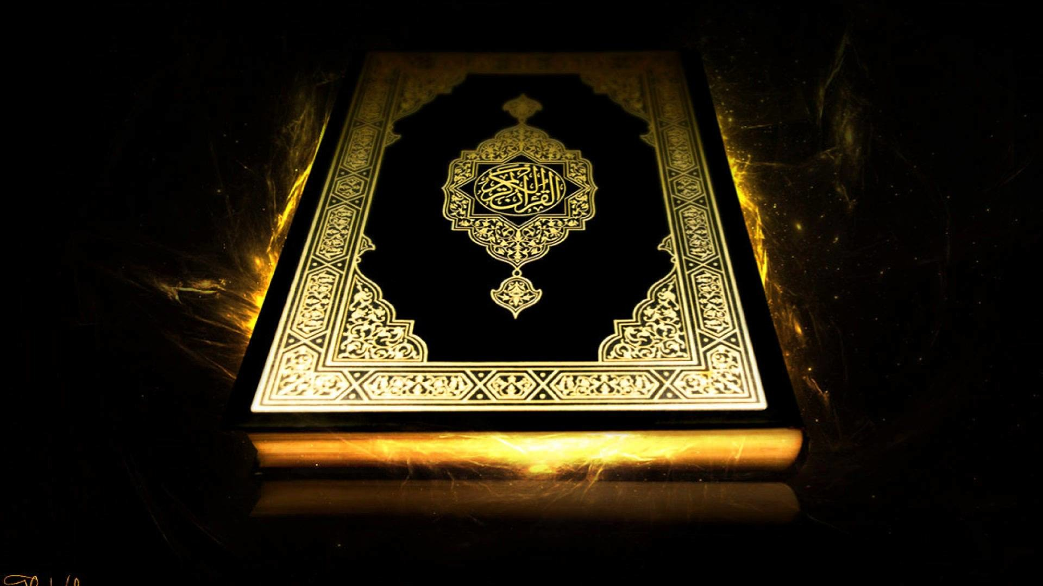
How does the QUR’AN
Influence Muslims today
www.learn-islam.co.uk

Slide 3
It is a guidance for all mankind
What’s Special?
Basis for Muslims morals (objective morality)
Linguistic Miracle
www.learn-islam.co.uk

Slide 4
How did it come about?
It was first revealed to Muhammad by the archangel Gabriel in a cave.
Orally transmitted by memorisation
On the mountain of Hira in Mecca
Continued to be revealed over a period of twenty-three years until his death.
Muslims memorise the Quran word by word since then
Also written in different forms by followers
Over 23 Years
In a cave
www.learn-islam.co.uk

Slide 5
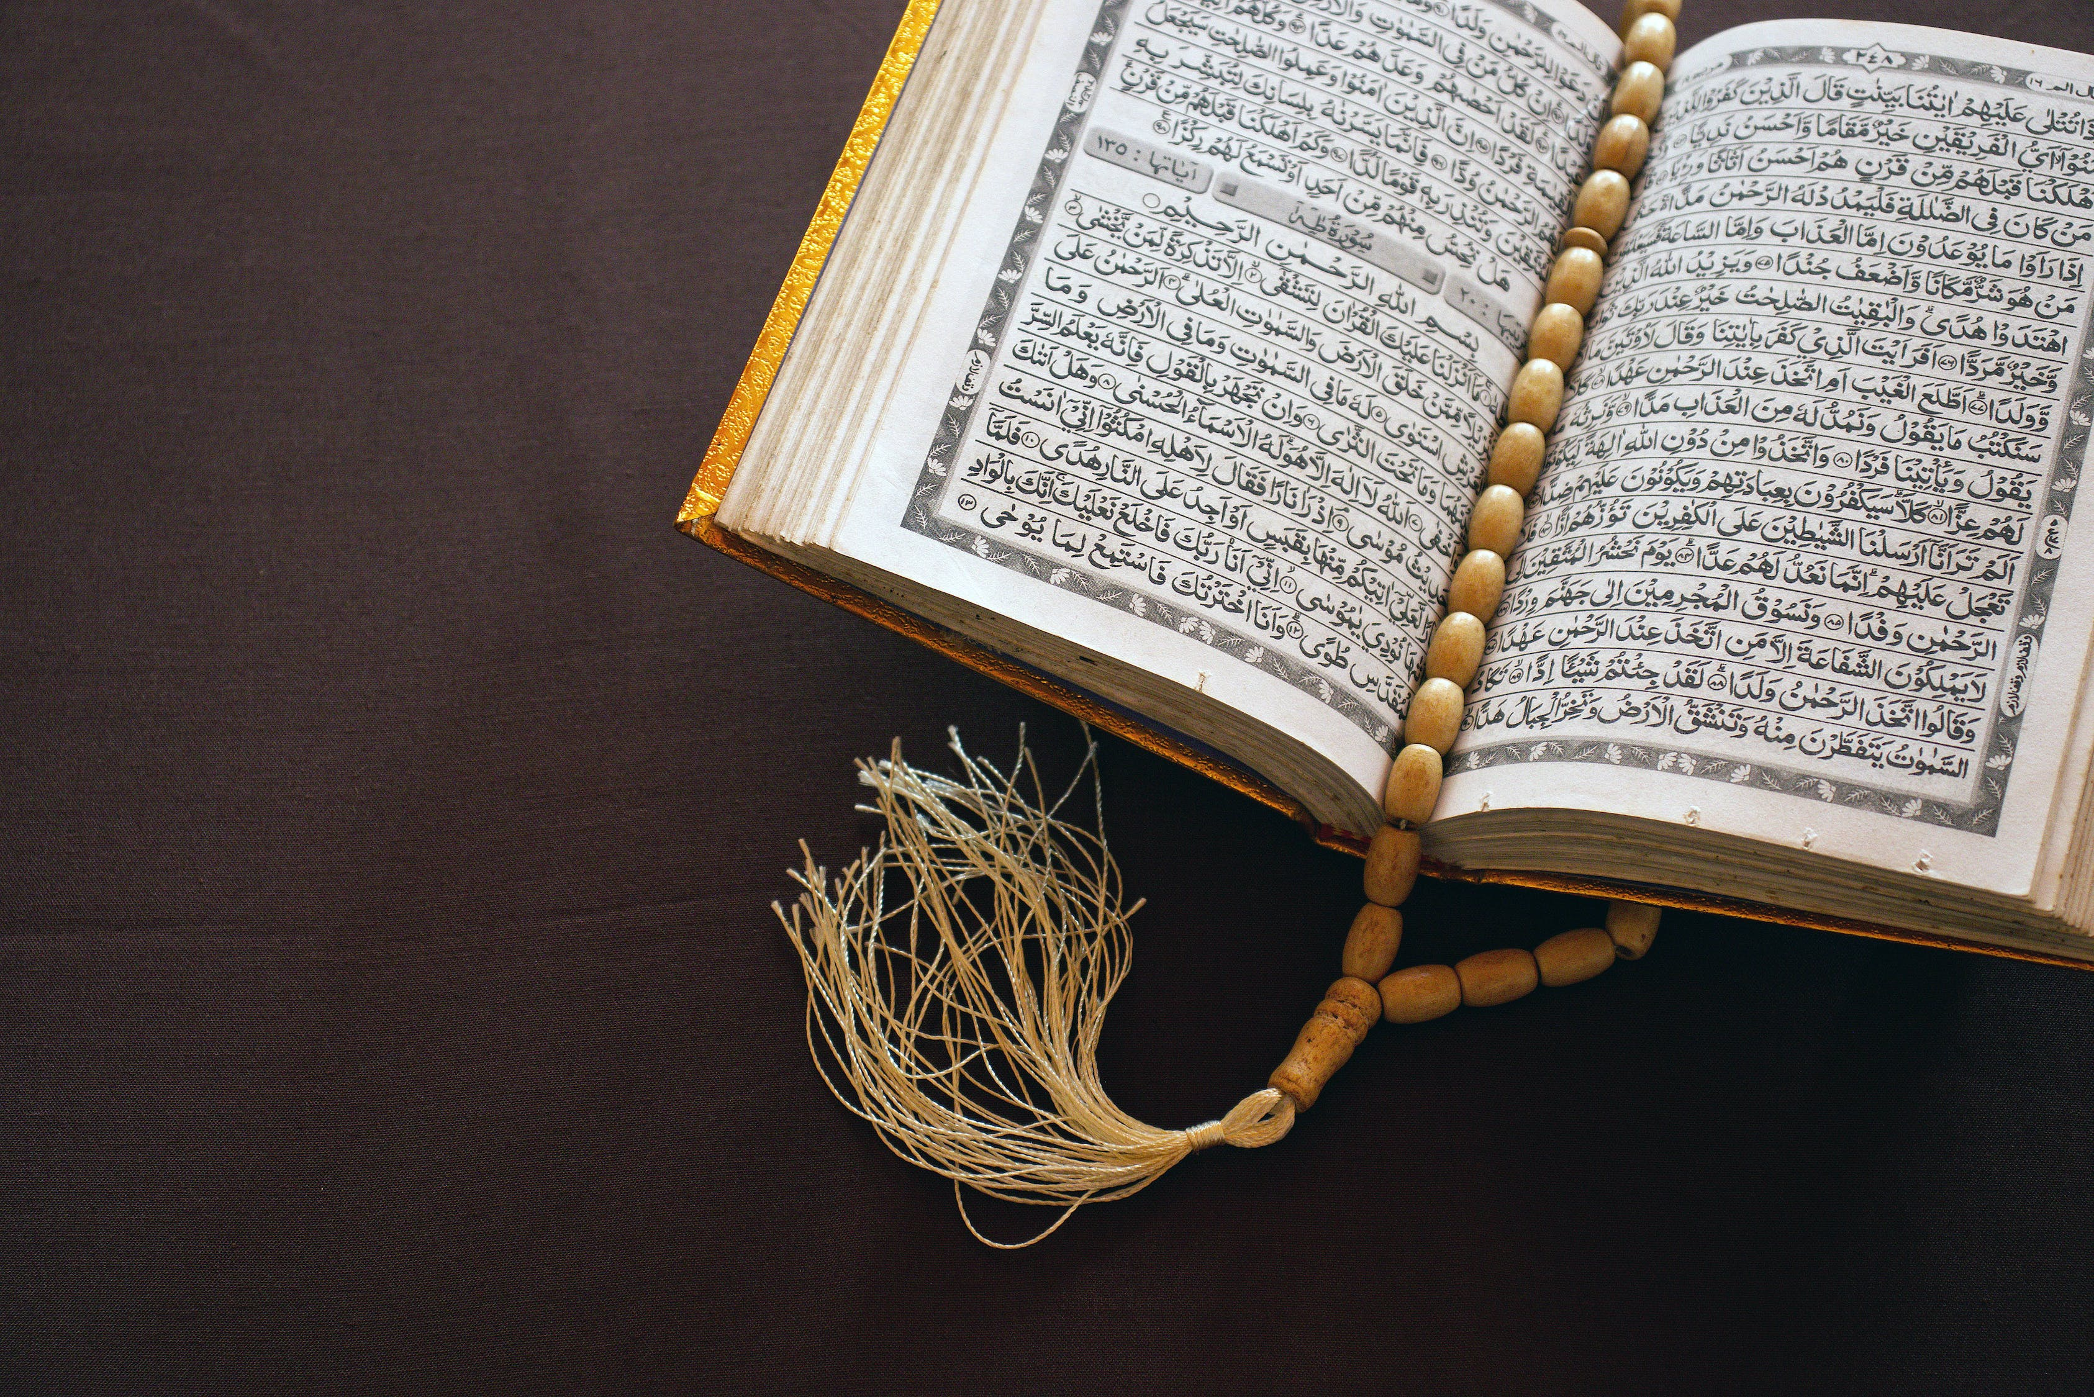
Interesting Facts
Oldest Quran from 1st Century in Birmingham
Predicted future events
Contains scientific details that were not known
www.learn-islam.co.uk

Slide 6
Interesting Facts
Mentions Jesus by name more than Muhammad
Challenges anyone to bring something like it
It is considered to be the final book from the Abrahamic faiths
www.learn-islam.co.uk

Slide 7
Visit www.learn-islam.co.uk for more resources

