Slide 1

FREE Islamic Resources for Educational Institutions
Creative Commons Non-Commercial, No-Derivatives License

Slide 2
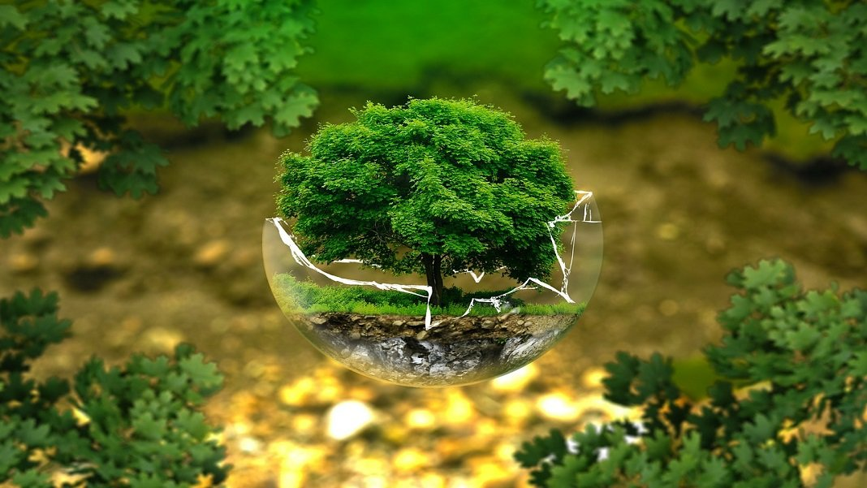
How Islam encourages Muslims to take care of the world?
www.learn-islam.co.uk

Slide 3
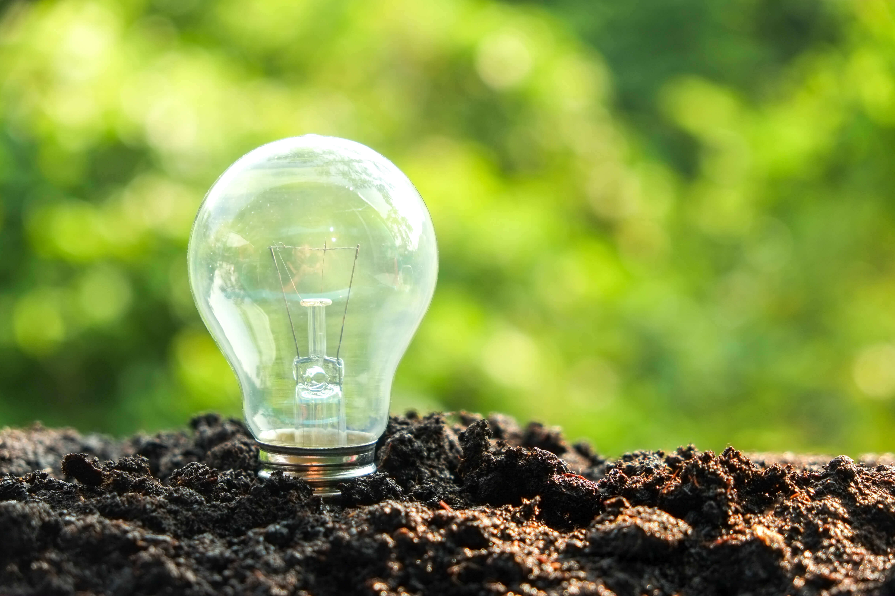
Conserve Resources
Muslims are required to practice conservation
Don’t Waste Energy
Muhammad (PBUH) used 2 litres per bath
Don’t Waste Water
Electricity or Gas
www.learn-islam.co.uk

Slide 4
Consumption Control
Two Thirds Full
One third stomach empty
Reduce, Re-use, Recycle
Prophet (PBUH) would mend his sandals, patch his garments
www.learn-islam.co.uk

Slide 5
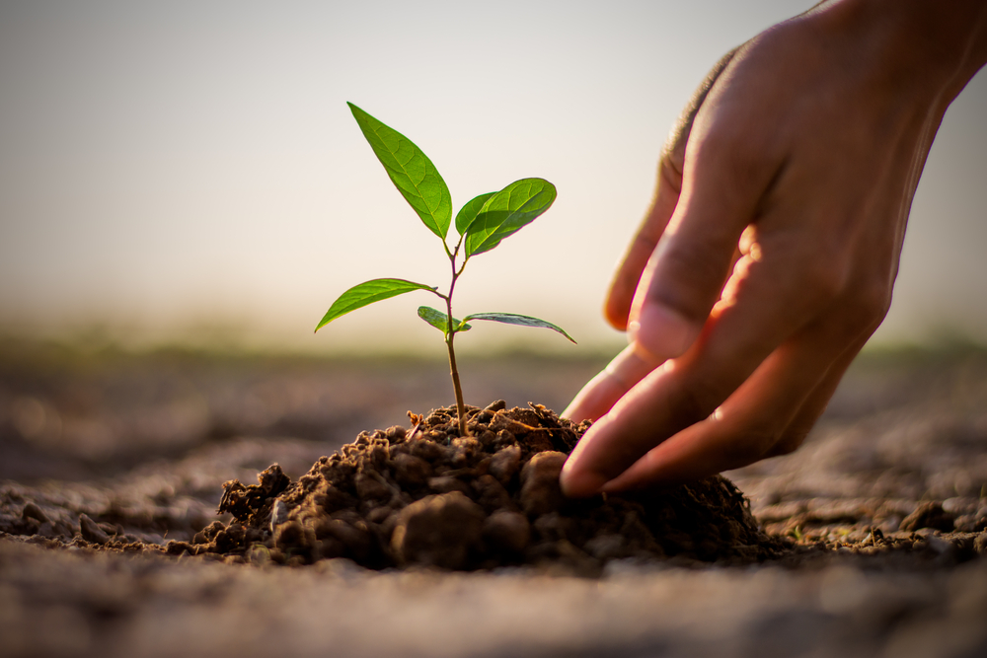
Plant Trees
“There is none amongst the Muslims who plants a tree or sows seeds, and then a bird, or a person or an animal eats from it, but is regarded as a charitable gift”.
Direct Impact – birds, animals, humankind benefit from branches, barks, leaves and fruits.
Indirect Impact – Preservation of Earth, caring for the environment
www.learn-islam.co.uk

Slide 6
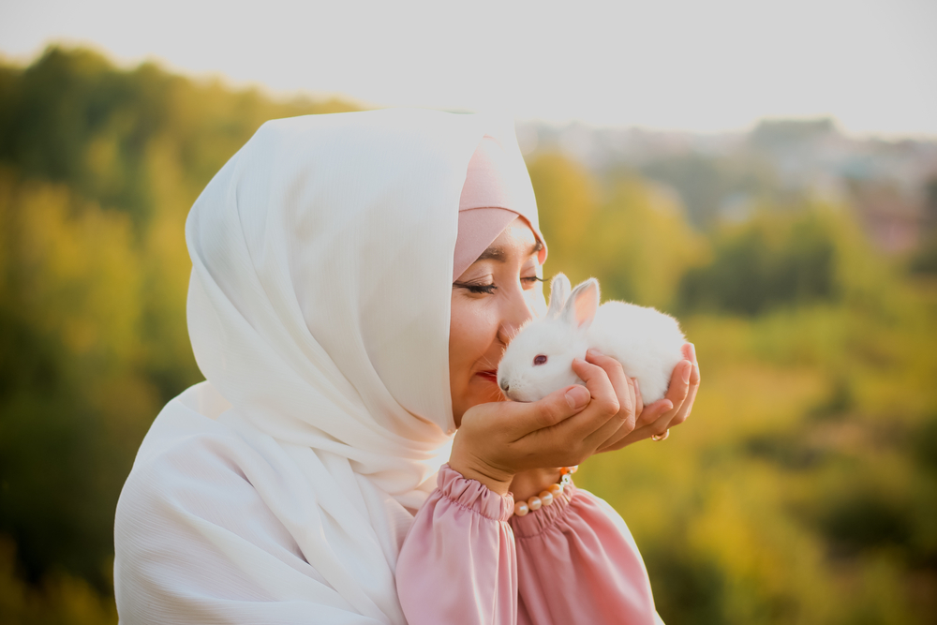
Help Living Beings
It is very important to serve and care for the living beings on Earth - animals included
“There is a reward for serving any living being” Sahih Al-Bukhari
www.learn-islam.co.uk

Slide 7
Keep It Clean
“While a man was walking along a path, he found a thorny branch of a tree on the way and removed it. Allah thanked him for that deed and forgave him”.
There is a great reward for removing whatever deems to be harmful when embarking on any path and keeping areas clean
www.learn-islam.co.uk

Slide 8
It’s Our Responsibility
“No doubt, every one of you is a shepherd and is responsible for his flock”.
It matters not the size of the problem at hand, but what weighs greater are the efforts that we consciously put in and take ownership upon what we are responsible for.
www.learn-islam.co.uk

Slide 9
Visit www.learn-islam.co.uk for more resources

